Slide 1


Slide 2
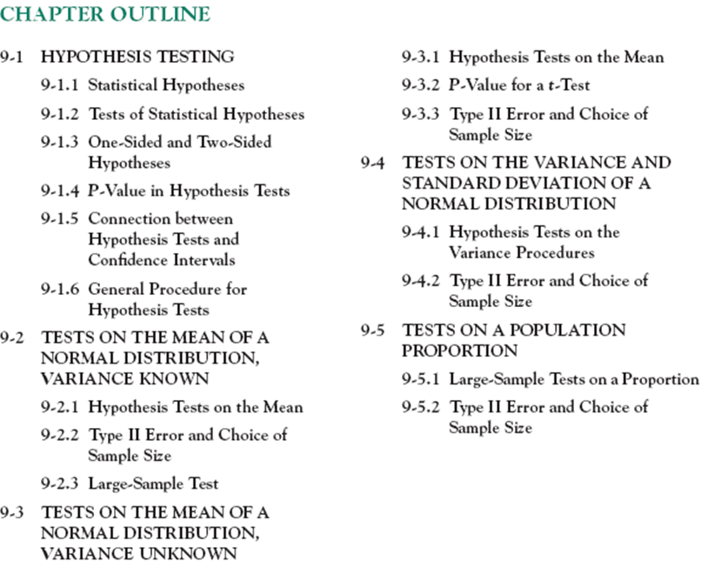

Slide 3
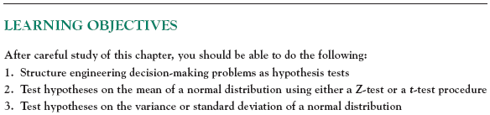
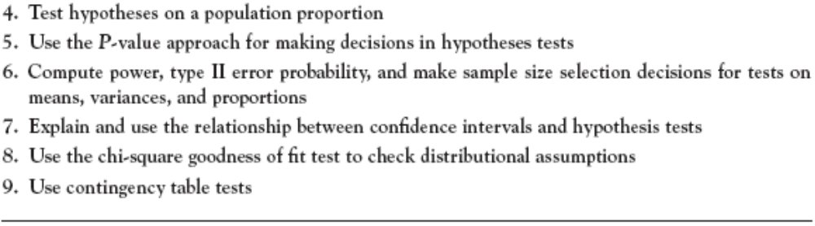

Slide 4
9-1 Hypothesis Testing
9-1.1 Statistical Hypotheses
Definition

Slide 5
9-1 Hypothesis Testing
9-1.1 Statistical Hypotheses
For example, suppose that we are interested in the burning rate of a solid propellant used to power aircrew escape systems.
Now burning rate is a random variable that can be described by a probability distribution.
Suppose that our interest focuses on the mean burning rate (a parameter of this distribution).
Specifically, we are interested in deciding whether or not the mean burning rate is 50 centimeters per second.

Slide 6

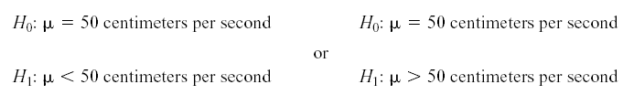
9-1 Hypothesis Testing
9-1.1 Statistical Hypotheses
Two-sided Alternative Hypothesis
null hypothesis
alternative hypothesis
One-sided Alternative Hypotheses

Slide 7
9-1 Hypothesis Testing
9-1.1 Statistical Hypotheses
Test of a Hypothesis
A procedure leading to a decision about a particular hypothesis
Hypothesis-testing procedures rely on using the information in a random sample from the population of interest.
If this information is consistent with the hypothesis, then we will conclude that the hypothesis is true; if this information is inconsistent with the hypothesis, we will conclude that the hypothesis is false.

Slide 8

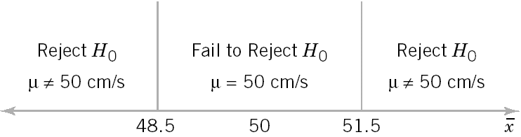
9-1 Hypothesis Testing
9-1.2 Tests of Statistical Hypotheses
Figure 9-1 Decision criteria for testing H₀:μ = 50 centimeters per second versus H₁:μ ≠ 50 centimeters per second.

Slide 9
9-1 Hypothesis Testing
9-1.2 Tests of Statistical Hypotheses
Definitions

Slide 10
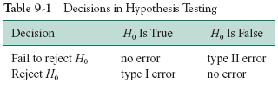
9-1 Hypothesis Testing
9-1.2 Tests of Statistical Hypotheses
Sometimes the type I error probability is called the significance level, or the α-error, or the size of the test.

Slide 11
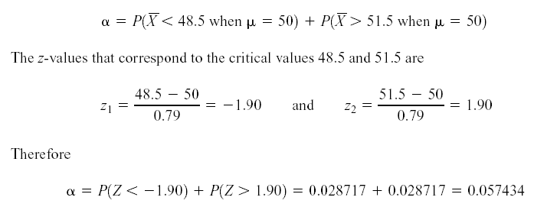
9-1 Hypothesis Testing
9-1.2 Tests of Statistical Hypotheses

Slide 12
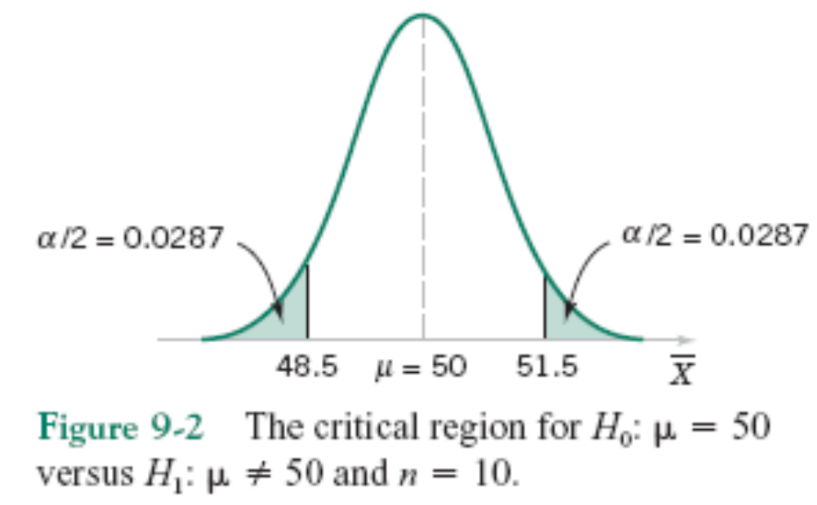
9-1 Hypothesis Testing

Slide 13
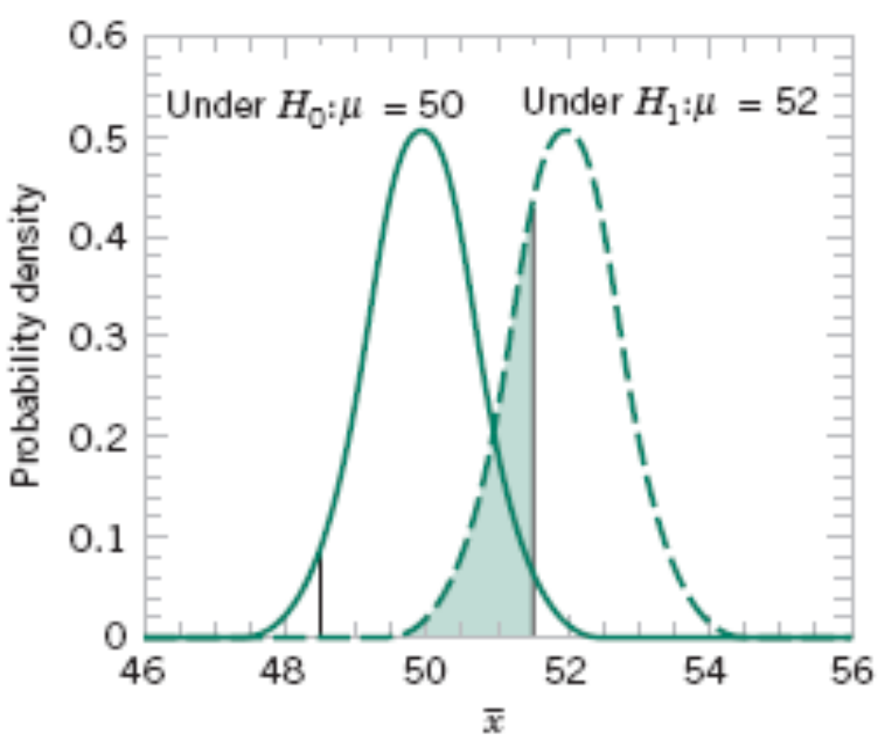
9-1 Hypothesis Testing
Figure 9-3 The probability of type II error when μ = 52 and n = 10.

Slide 14
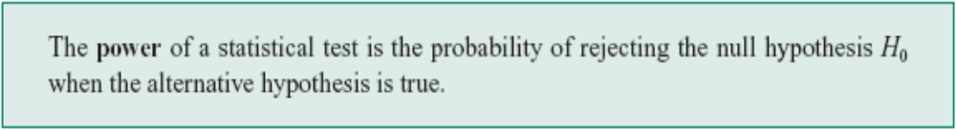
9-1 Hypothesis Testing
Definition
The power is computed as 1 - β, and power can be interpreted as the probability of correctly rejecting a false null hypothesis. We often compare statistical tests by comparing their power properties.
For example, consider the propellant burning rate problem when
we are testing H ₀ : μ = 50 centimeters per second against H ₁ : μ not equal 50 centimeters per second . Suppose that the true value of the mean is μ = 52. When n = 10, we found that β = 0.2643, so the power of this test is 1 - β = 1 - 0.2643 = 0.7357 when μ = 52.

Slide 15


9-1 Hypothesis Testing
9-1.3 One-Sided and Two-Sided Hypotheses
Two-Sided Test:
One-Sided Tests:

Slide 16
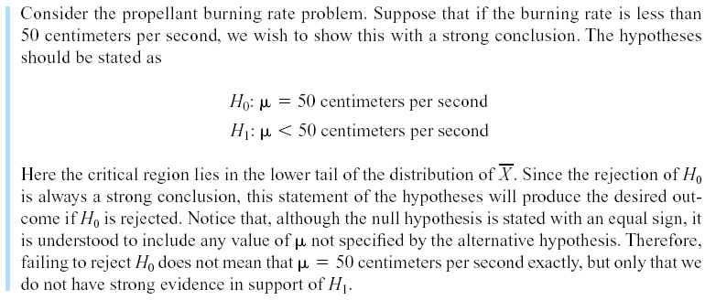
9-1 Hypothesis Testing
Example 9-1
Notes:
Propellant: chat nổ

Slide 17
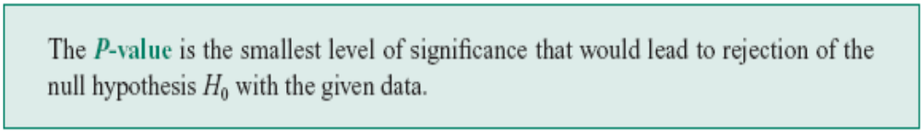
9-1 Hypothesis Testing
9-1.4 P-Values in Hypothesis Tests
Definition

Slide 18
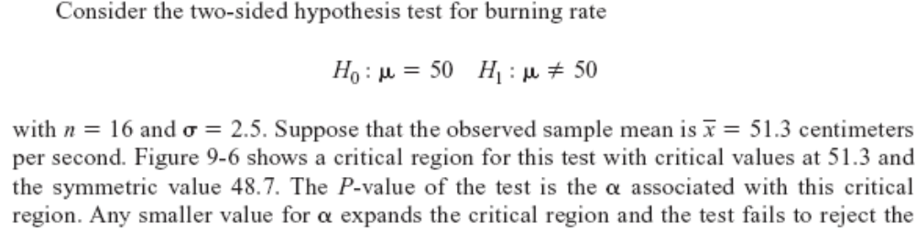
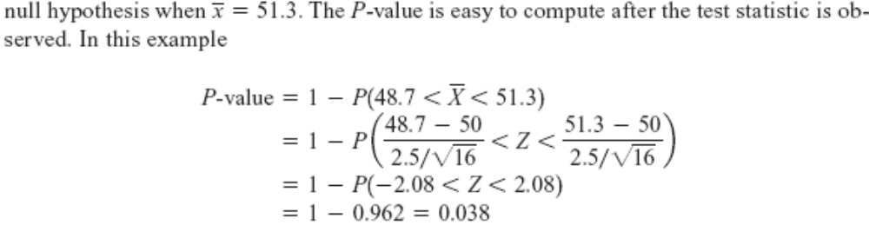
9-1 Hypothesis Testing
9-1.4 P-Values in Hypothesis Tests

Slide 19
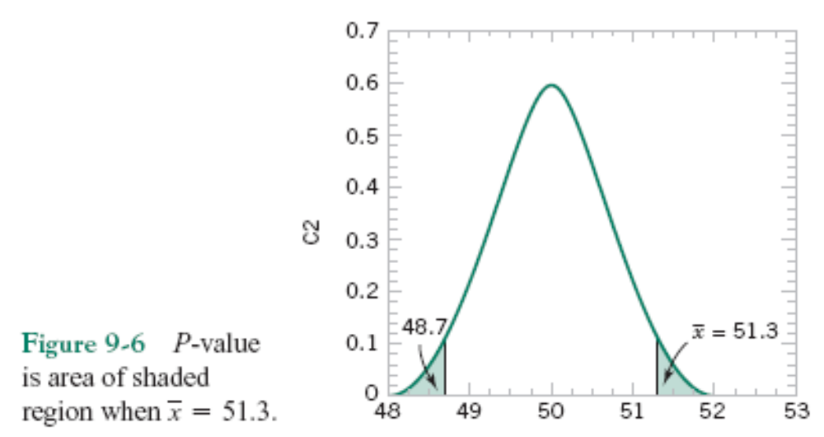
9-1 Hypothesis Testing
9-1.4 P-Values in Hypothesis Tests

Slide 20
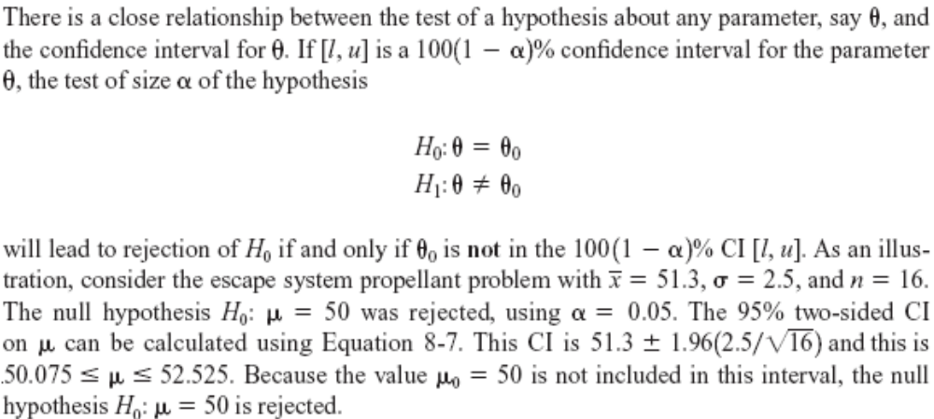
9-1 Hypothesis Testing
9-1.5 Connection between Hypothesis Tests and Confidence Intervals

Slide 21
9-1 Hypothesis Testing
9-1.6 General Procedure for Hypothesis Tests
1. From the problem context, identify the parameter of interest.
2. State the null hypothesis, H₀ .
3. Specify an appropriate alternative hypothesis, H₁.
4. Choose a significance level, α.
5. Determine an appropriate test statistic.
6. State the rejection region for the statistic.
7. Compute any necessary sample quantities, substitute these into the equation for the test statistic, and compute that value.
8. Decide whether or not H₀ should be rejected and report that in the problem context.

Slide 22


9-2 Tests on the Mean of a Normal Distribution, Variance Known
9-2.1 Hypothesis Tests on the Mean
We wish to test:
The test statistic is:

Slide 23
9-2 Tests on the Mean of a Normal Distribution, Variance Known
9-2.1 Hypothesis Tests on the Mean
Reject H₀ if the observed value of the test statistic z₀ is either:
z₀ > z_{α/2} or z₀ < -z_{α/2}
Fail to reject H₀ if
-z_{α/2} < z₀ < z_{α/2}

Slide 24
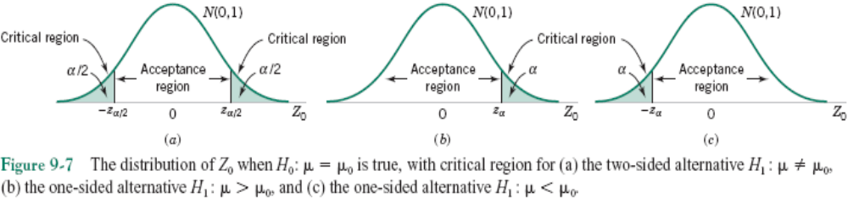
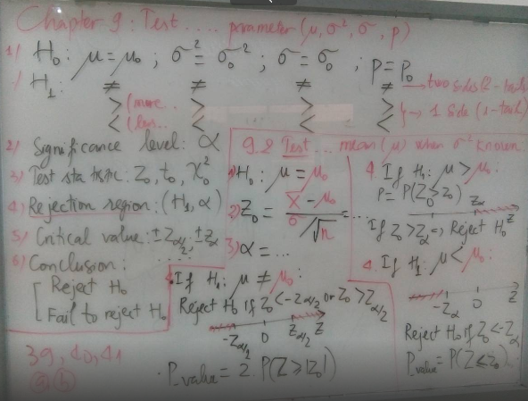
9-2 Tests on the Mean of a Normal Distribution, Variance Known

Slide 25
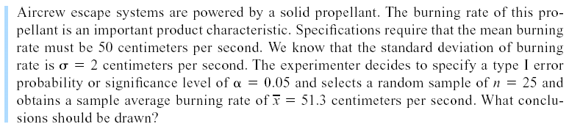
9-2 Tests on the Mean of a Normal Distribution, Variance Known
Example 9-2

Slide 26
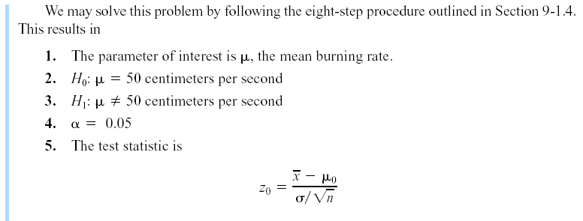
9-2 Tests on the Mean of a Normal Distribution, Variance Known
Example 9-2

Slide 27
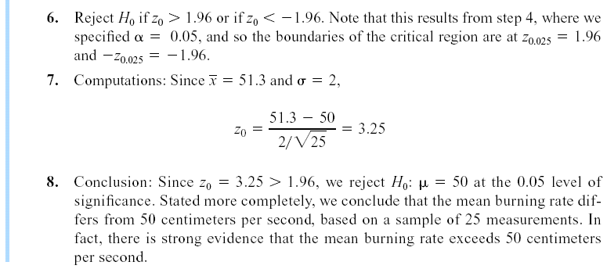
9-2 Tests on the Mean of a Normal Distribution, Variance Known
Example 9-2

Slide 28
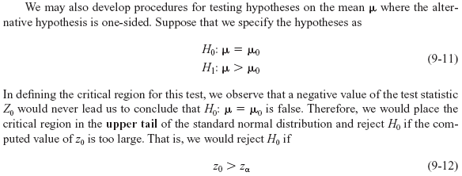
9-2 Tests on the Mean of a Normal Distribution, Variance Known
9-2.1 Hypothesis Tests on the Mean

Slide 29
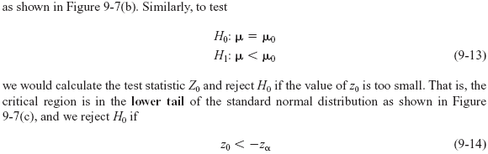
9-2 Tests on the Mean of a Normal Distribution, Variance Known
9-2.1 Hypothesis Tests on the Mean (Continued)

Slide 30
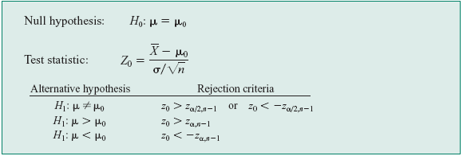
9-2 Tests on the Mean of a Normal Distribution, Variance Known
9-2.1 Hypothesis Tests on the Mean (Continued)

Slide 31

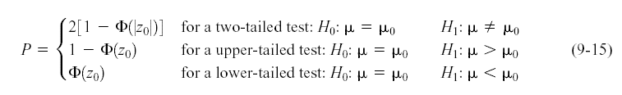
9-2 Tests on the Mean of a Normal Distribution, Variance Known
P-Values in Hypothesis Tests

Slide 32
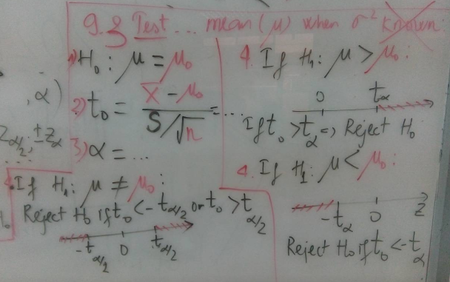
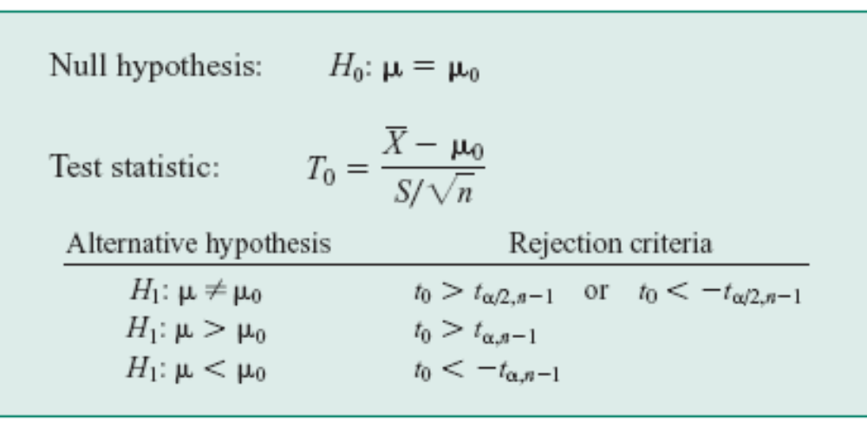
9-3 Tests on the Mean of a Normal Distribution, Variance Unknown
9-3.1 Hypothesis Tests on the Mean
One-Sample t-Test

Slide 33
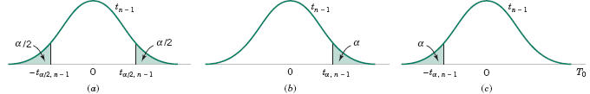
9-3 Tests on the Mean of a Normal Distribution, Variance Unknown
9-3.1 Hypothesis Tests on the Mean
Figure 9-9 The reference distribution for H₀: μ = μ₀ with critical region for (a) H₁: μ ≠ μ₀ , (b) H₁: μ > μ₀, and (c) H₁: μ < μ₀.

Slide 34
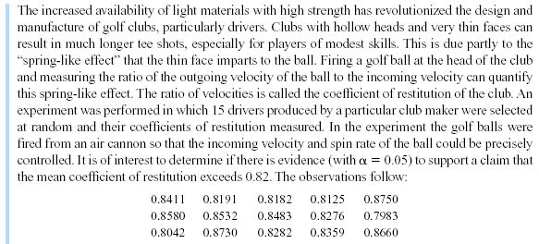
9-3 Tests on the Mean of a Normal Distribution, Variance Unknown
Example 9-6
Notes:
Club: gay đánh gôn; hollow: rỗng; restitution: sự phục hồi;

Slide 35
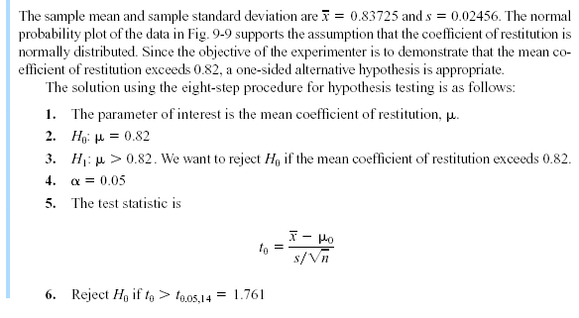
9-3 Tests on the Mean of a Normal Distribution, Variance Unknown
Example 9-6

Slide 36
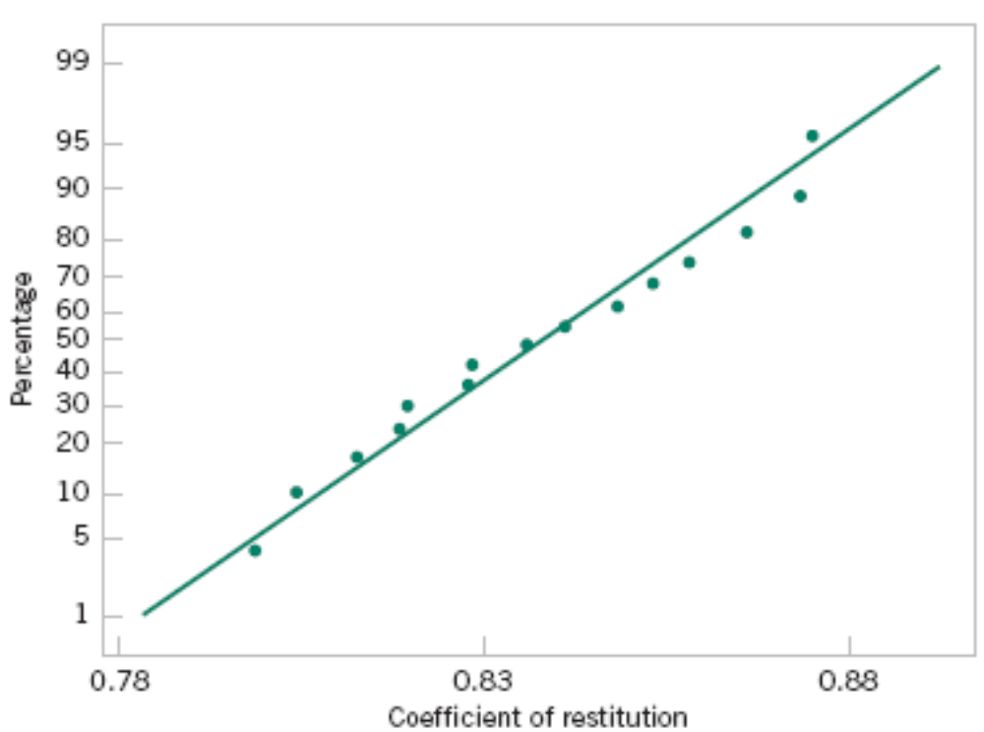
9-3 Tests on the Mean of a Normal Distribution, Variance Unknown
Example 9-6
Figure 9-10 Normal probability plot of the coefficient of restitution data from Example 9-6.

Slide 37
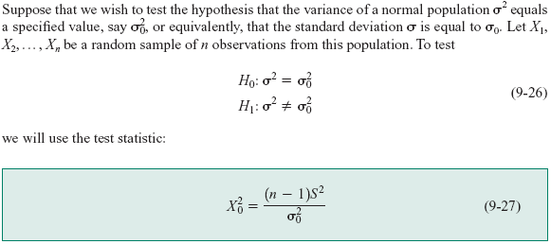
9-4 Hypothesis Tests on the Variance and Standard Deviation of a Normal Distribution
9-4.1 Hypothesis Test on the Variance

Slide 38
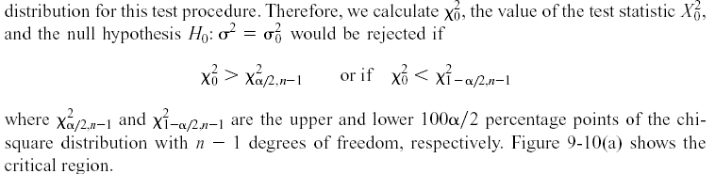
9-4 Hypothesis Tests on the Variance and Standard Deviation of a Normal Distribution
9-4.1 Hypothesis Test on the Variance

Slide 39
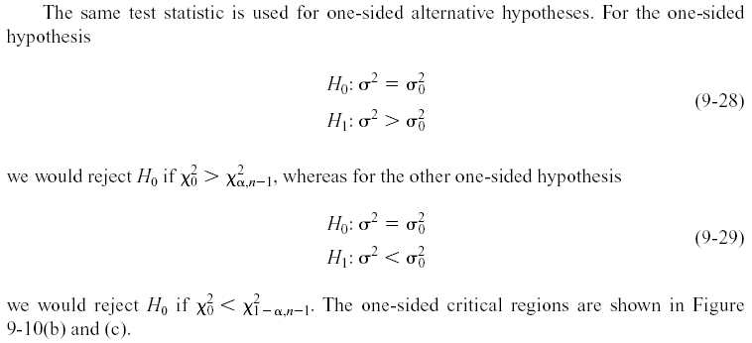
9-4 Hypothesis Tests on the Variance and Standard Deviation of a Normal Distribution
9-4.1 Hypothesis Test on the Variance

Slide 40
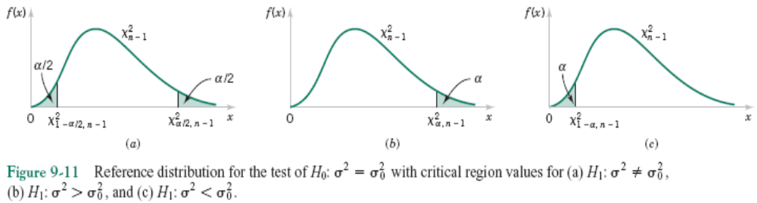
9-4 Hypothesis Tests on the Variance and Standard Deviation of a Normal Distribution
9-4.1 Hypothesis Test on the Variance

Slide 41
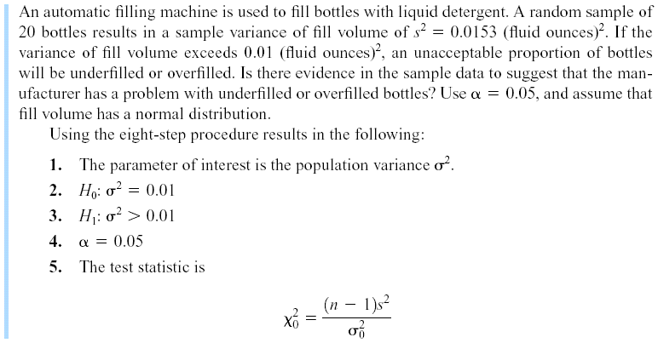
9-4 Hypothesis Tests on the Variance and Standard Deviation of a Normal Distribution
Example 9-8
Notes:
Detergent: chất tẩy;

Slide 42
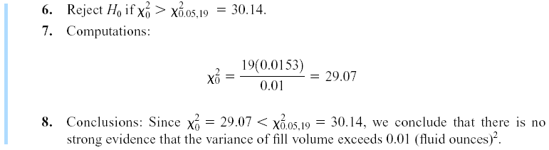
9-4 Hypothesis Tests on the Variance and Standard Deviation of a Normal Distribution
Example 9-8

Slide 43

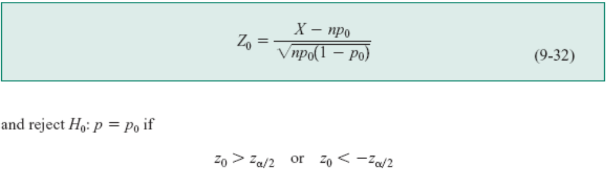
9-5 Tests on a Population Proportion
9-5.1 Large-Sample Tests on a Proportion
Many engineering decision problems include hypothesis testing about p.
An appropriate test statistic is

Slide 44
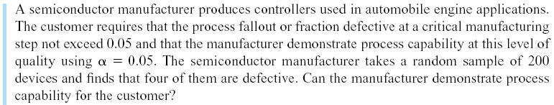
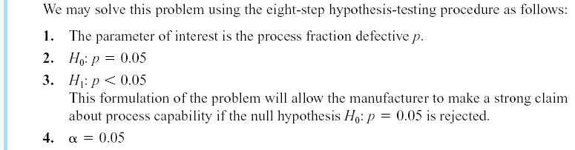
9-5 Tests on a Population Proportion
Example 9-10

Slide 45
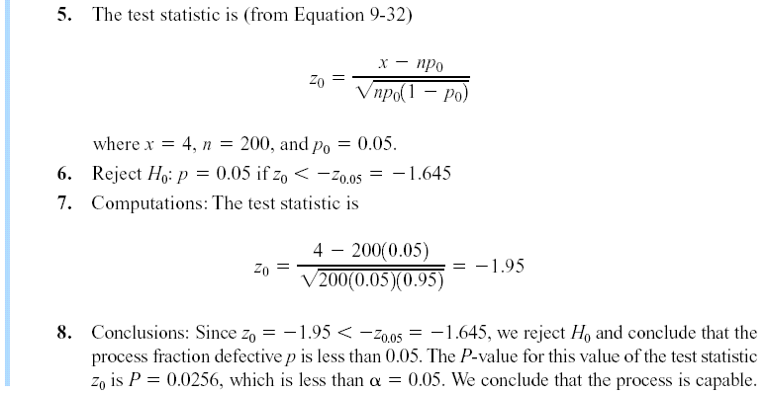
9-5 Tests on a Population Proportion
Example 9-10

Slide 46


9-5 Tests on a Population Proportion
Another form of the test statistic Z₀ is
or

Slide 47
